Slide 1
Exhaustive Search
THE GOLD Collector

Slide 2
Problem description:
A series of Gold wagons with different weights (ton) passes through an automated collecting mechanism. But, unfortunately, the mechanism is somewhat broken!
It can either skip the current wagon to go to the next one, or collect the current wagon and skip the next one.
Find the max amount of gold that this machine can collect, given a series of wagon.

Slide 3
Approaching the problem:
There are two choices:
1. Skip the current wagon.
2. Collect it and skip the next one.
The stopping condition:
There are no more wagons.

Slide 4
Let the wagons be represented by an array of numbers:
Skipping:
21 | 14
Deciding for this one in the next recursive call
Skipped
Collecting:
21 | 14 | 32
Deciding for this one in the next recursive call
Collected
Skipped

Slide 5
Example:
33 | 10 | 20 | 5 | 14 | 26
Given:
One way of collecting:
33 | 10 | 20 | 5 | 14 | 26
Amount: 79
Another way:
33 | 10 | 20 | 5 | 14 | 26
Amount: 41

Slide 6
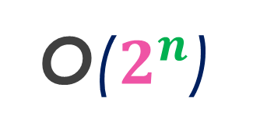
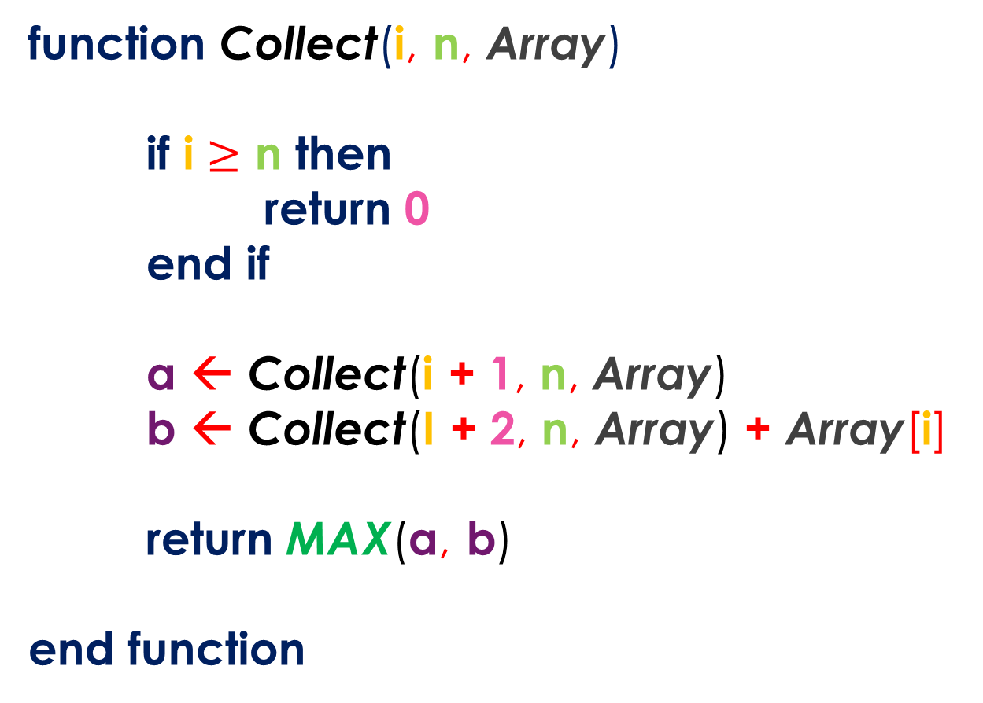
Code representation:
function Collect(i, n, Array)
if i $≥$ n then
return 0
end if
a ← Collect(i + 1, n, Array)
b ← Collect(I + 2, n, Array) + Array[i]
return MAX(a, b)
end function
No more wagons
O($2^{n}$)
Skipping
Collecting
Returning optimal value

Slide 7
Are here any overlapping cases?
Watch this sub-solution:
33 | 10 | 20 | 5 | 14 | 26

Slide 8
Are here any overlapping cases?
Watch this sub-solution:
33 | 10 | 20 | 5 | 14 | 26
Amount: 53

Slide 9
Are here any overlapping cases?
Watch this sub-solution:
33 | 10 | 20 | 5 | 14 | 26
Amount: 67

Slide 10
Are here any overlapping cases?
Watch this sub-solution:
33 | 10 | 20 | 5 | 14 | 26
Amount: 79

Slide 11
Are here any overlapping cases?
Watch this sub-solution:
33 | 10 | 20 | 5 | 14 | 26
Amount: 79
Clearly there are overlapping cases

Slide 12
How to use Memoization here?
Or bottom-up DP (Tabulation)?

Slide 13
The code can be represented as a recurrence-relation.
$${Collect}_{n}=Max\left\{{Collect}_{n−1}, {Collect}_{n−2}+ {Array}_{n}\right\}$$
Thus a 1D Array should suffice for Memoization/Tabulation.
I will use Memoization.
Memo[n]

Slide 14
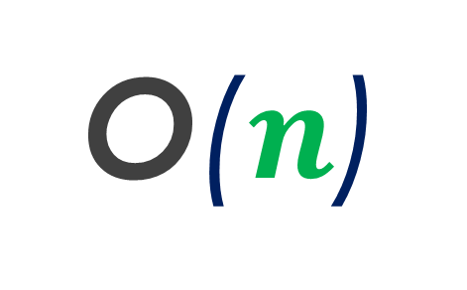
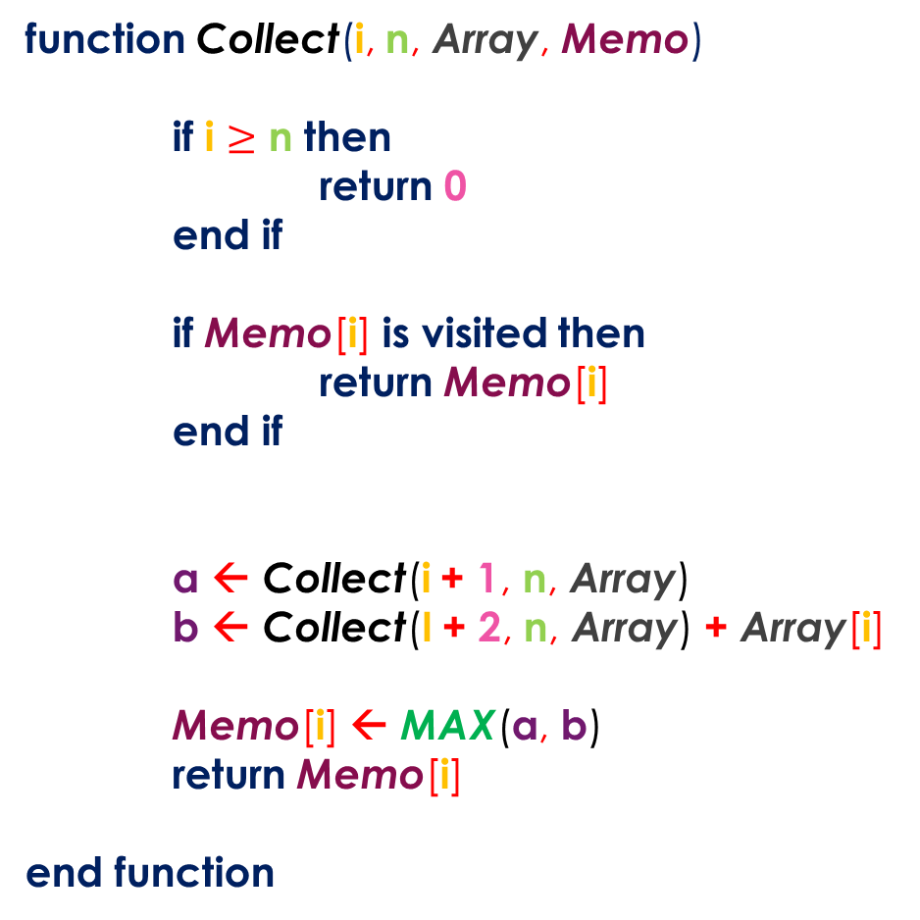
O($n$)
function Collect(i, n, Array, Memo)
if i $≥$ n then
return 0
end if
if Memo[i] is visited then
return Memo[i]
end if
a ← Collect(i + 1, n, Array)
b ← Collect(I + 2, n, Array) + Array[i]
Memo[i] ← MAX(a, b)
return Memo[i]
end function
Do not recompute
Happens once for each position

Slide 15
O($n$)
Bottom-Up/Tabulation
function Collect(n, Array, Table)
Table[0] ← Array[0]
Table[1] ← MAX(Array[1], Table[0])
for(i from 2 to n - 1 step 1)
Table[i] ← MAX(Table[i - 1], Table[i - 2] + Array[i])
end loop
return Table[n - 1]
end function
First elements
Tabulation

Slide 16
Thank you!
To be continued…

